Slide 1
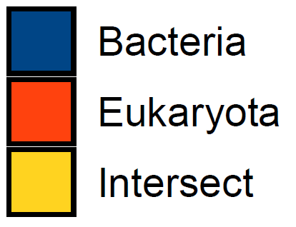

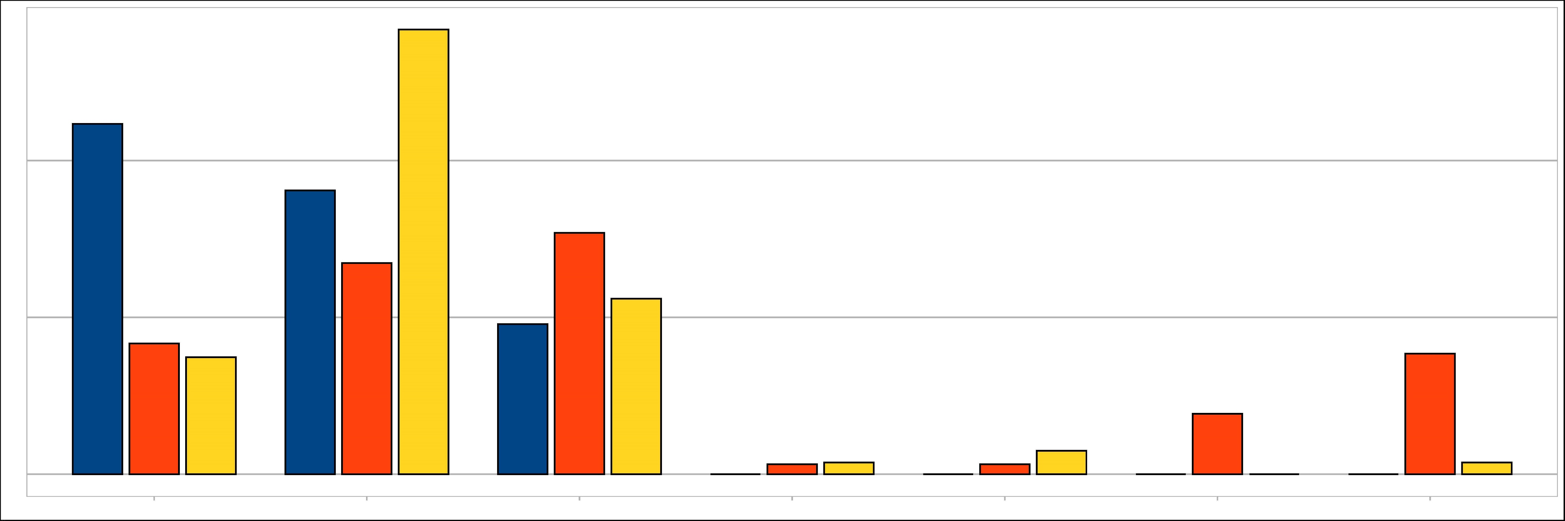
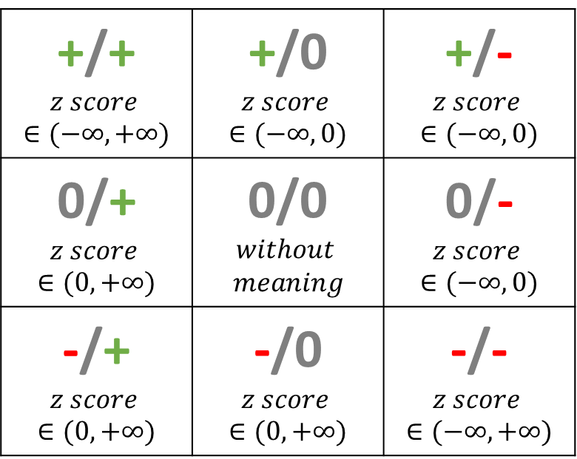
a
z-score represents of the relative strength of differential correlation
Density graph with z-score (CRC vs control)
0.3
0.08
Bac & Bac
Intra-bacteria
Density
0.06
Euk & Euk
Intra-fungi
0.04
Fungi-bacteria
0.02
Bac & Euk
0.00
-10
0
10
20
30
0.2
0.08
Density
Density
0.06
0.04
0.02
0.1
0.00
-10
0
10
20
30
0.15
Density
0.10
0.0
0.05
-10
0
10
20
30
0.00
-10
0
10
20
30
z-score
z-score
b
Definition of differential correlation classes
Differential correlation classes (%)
Feature Pair Correlation in control
56.72%
Feature Pair Correlation in CRC
ρ > 0
p < 0.05
p > 0.05
ρ < 0
p < 0.05
Intra-bacteria
ρ > 0
p < 0.05
+/+ $$z score ∈(−∞, +∞)$$ | +/0 $$z score ∈(−∞, 0)$$ | +/- $$z score ∈(−∞, 0)$$
0/+ $$z score ∈(0, +∞)$$ | 0/0 $$without$$ $$meaning$$ | 0/- $$z score ∈(−∞, 0)$$
-/+ $$z score ∈(0, +∞)$$ | -/0 $$z score ∈(0, +∞)$$ | -/- $$z score ∈(−∞, +∞)$$
44.68%
Intra-fungi
40%
36.17%
Fungi-bacteria
p < 0.05
26.92%
30.77%
20%
16.67%
19.15%
22.39%
14.93%
15.38%
ρ < 0
p < 0.05
1.49%
2.99%
7.69%
0.0%
1.28%
1.28%
0.0%
0.0%
0.0%
1.49%
0%
0.0%
+/+
+/0
0/+
0/0
0/-
-/+
-/0
S figure 6 Comparison of differential relationship between CRC and healthy control. (a) Density graph with z-score of intra-bacterial, intra-fungal, and fungal-bacterial correlational comparisons. Left panel: the stacked density chart in all correlational comparisons. Right-top panel: the density plot for z-score of intra-bacteria. Right-middle : the density plot for z-score of intra-fungi. Right-bottom: the density plot for z-score of fungi-bacteria. (b) Left panel: definition of differential correlation classes. The front and back of the semicolon represent the characteristics of the relationship in CRC and the healthy control, respectively. Right panel: percentage of differential correlational classes. Blue, orange, and yellow bar represented the intra-bacterial, intra-fungal, and fungal-bacterial groups, respectively.

